Slide 1
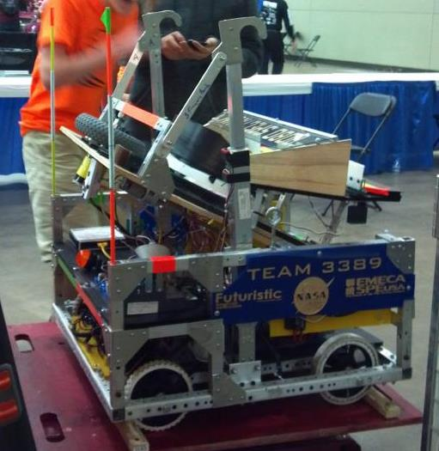
Robotics In Search of the Do-all Robot
LabRat Scientific
© 2018

Slide 2
The “Do-All” robot is a robot that can perform all of the required tasks and do each of them really well.
While it is understandable that a design team would aspire to design and build a robot that can do everything that is required, it is actually much easier said than done…
Let’s look at a real-life example of a device that tries to be too many things…

Slide 3
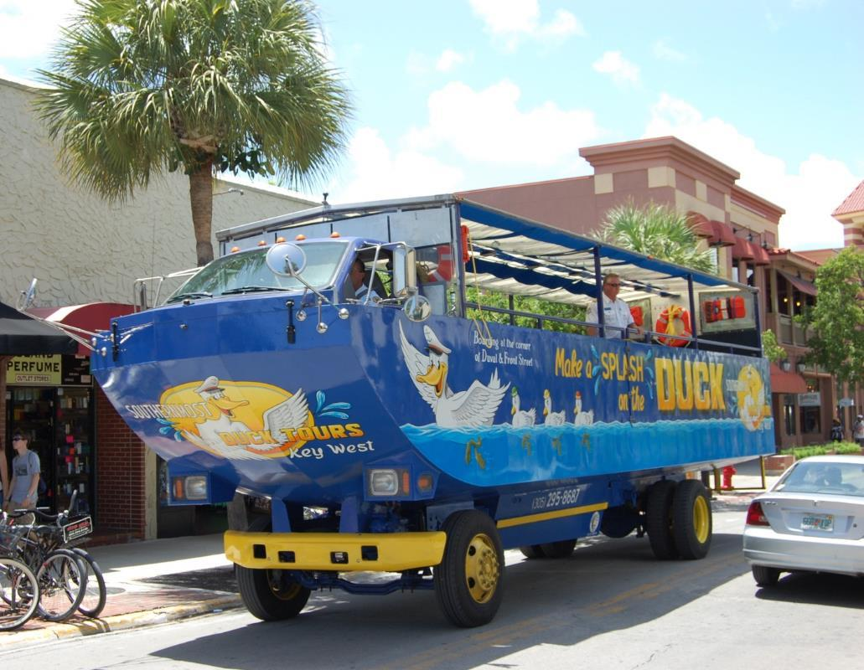
The Duck
Example of a vehicle that attempts to be two different things…
The “Duck” was designed to be both a bus and a boat.
While the vehicle achieved both goals and it looks cool, it isn’t a real good bus, nor is it a real good boat…
Just think if they also designed it to fly and race in the Indy 500!

Slide 4
Is the “Do All” Robot Possible?
YES, it is possible to design and build a robot that can perform all of the tasks, cover every contingency, and do it all well…
But, several critical factors come into play:
1. Funding (Sophisticated parts cost money… Can you get enough money?)
2. Dedicated mentors (One adult can’t handle the effort and mentors need skills.)
3. Dedicated and highly focused students
4. Schedule (Is there enough time?)
5. Robot Weight (More functions = more weight… Your robot may weigh too much)

Slide 5
Let’s take a look at some of the challenges one can expect to encounter when tackling a complex robot build.

Slide 6
Challenges
Robotics competitions tend to have very complex requirements, and usually have a relatively short amount time for designing, building, and testing.
Competitions usually require the robot to do many tasks in order to score points. It is very tempting to attempt to design a robot that can do everything.
The numerous and varying task requirements are not established by accident. The complex requirements are intended to make the teams develop a strategy and then make tough design choices based on the skill level of their teams.
While it is possible to develop a robot that can achieve all of the objectives, it is actually VERY difficult.

Slide 7
Challenges
DESIGN: Good designers have experience and/or engineering knowledge. Students typically have neither (it’s just a fact of life). This will greatly extend the design phase of the project.
CONSTRUCTION: Students will probably have limited skills when it comes to using tools. This is especially acute when more tools such as lathes and milling machines are needed. Experience has shown that a job that should take less than an hour will take nearly four hours when an inexperienced student attempts the job alone.
SOFTWARE PROGRAMMING: Depending on the competition, software programming may be required. While high-level programming platforms are generally used in the competitions, linking together the necessary software modules can be very complicated. A mentor with programming experience is important.

Slide 8
Possible Project Execution Issues
Too much time may be spent on brainstorming and identifying potential mechanism concepts.
Design sub-teams may be reluctant to scrap their concept and may spend too much time trying to get a mock-up to work.
Students may take a lot longer than expected to complete tasks (even relatively simple tasks).
Large teams can be difficult to coordinate and keep motivated.
For a complex project with a time limit, it may be necessary to work several hours per day and 6 or 7 days per week. Can this much time be devoted to the effort?

Slide 9
Let’s review a couple past FIRST Robotics competitions and examine the goals and outcomes of a real FIRST Robotics team
It should be noted that this is just one team out of thousands. Results will obviously vary due to team experience and technical strengths of the students and mentors.

Slide 10
FIRST Robotics Example A
Object of the Game:
Shoot Frisbees into various goals at the end of the playing field, then in the last 30 seconds of the match the robot must climb a large pyramid structure made out of 1.5” dia. steel tubing. Points are scored when Frisbees land in scoring bins with a higher score awarded to the more difficult bins. Points are also scored depending on how high the robot climbs at the end of the round. There are strict rules that govern how the robot can interface with the climbing structure. The number of Frisbees the robot can carry is limited, but they can be reloaded via a feeding slot at the far side of the field.
This is the condensed version of the rules. The actual competition rules composed a book that had more then 20 pages of instructions…

Slide 11
Design Goals Established by the Team
Be able to store 4 Frisbees
2. Be able to climb up all three levels
3. Fire from the distant loading zone – load & shoot w/o driving
4. Accommodate 0 Deg to 80 Deg shooting elevations
5. Auto targeting (let the computer aim the shooter)
6. Be able to play defense – get in the way…
7. Autonomous operation (operate on its own w/o human control)
8. Be able to shoot from anywhere on the field
9. Be able to push other robots around
10. Be able to shoot over defenders

Slide 12
The Solution
Climbing Arms and Shooter Elevation Mechanism
Frisbee Shooter Drive Wheel
Frisbee Holder
4-wheel Drive System

Slide 13
Achieved Design Elements
Color Code:
Accomplished
Partially Accomplished
Not Accomplished
1. Be able to store 4 Frisbees
2. Be able to climb up three levels
3. Fire from loading zone – load & shoot w/o driving
4. Accommodate 0 Deg to 80 Deg shooting elevations
5. Auto targeting
6. Be able to play defense – get in the way…
7. Autonomous operation
8. Be able to shoot from anywhere on the field
9. Be able to push other robots around
10. Be able to shoot over defenders

Slide 14
End Result
A good shooting mechanism was developed that could reach the targets from most locations on the playing field. However, it was difficult to actually score from long range so the value of this capability was limited. The team could have just focused on shooting from shorter range.
A lot to effort was put into the climbing aspect of the competition, but in the end the robot could only grab the lowest bar and pull itself off the floor for minimal points. Attempting to build the robot so it could climb to the top consumed a lot of effort that could have been better applied elsewhere.
A lot of effort was consumed by trying to develop an auxiliary “deflection-ramp” on the shooter that was intended to allow for 80+ Deg Frisbee shooting. The final mechanism had structural and mechanical issues that would have been problematic during the competition. This effort delayed the final development of the robot.

Slide 15
End Result
The robot could move forward and shoot from a pre-set angle during autonomous mode. However, actual auto-targeting was not achieved. The auto-targeting effort delayed programming efforts which then limited the amount of practice time that was available prior to the end of the build.
Weight issues made it necessary to incorporate a minimalistic 4-wheel drive system. This resulted in a robot that had maneuverability issues and didn’t have a whole lot of ability to push other robots around.
Delays in completing the robot prior to the ship date resulted in a lot of work needing to be done while at the competition. This resulted in several missed practice sessions. The missed sessions resulted in the system kinks being worked out during the actual competition.

Slide 16
FIRST Robotics Example B
Object of the Game:
Pick up sub-scale basketballs and shoot them into hoops located at different heights at the end of the playing field. Be able to cross a 5” high barrier in the middle of the field or manipulate titter-totter ramps that can be used get over the barrier. Balls can be picked up off the playing field by the robot or they can be manually loaded from a loading station at the far end of the field. The robot can carry no more than 3 balls at a time.
This is the condensed version of the rules. The actual competition rules composed a book that had more then 20 pages of instructions…

Slide 17
Design Goals Established by the Team
Be able to manipulate the ramp
2. Be able to climb over the center barrier
3. Fire from loading zone – load & shoot w/o driving
4. Allow for manual ball feeding in loading zone
5. Auto targeting (let the computer aim the shooter)
6. Fine shooter azimuth control / fine shooter elevation control
7. Be able to play defense – get in the way…
8. Autonomous operation (operate w/o human control)
9. Collect and store 3 balls
10. Be able to shoot from anywhere on the field
11. Be able to push other robots around
12. Be able to shoot over defenders

Slide 18
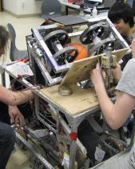
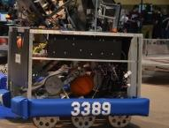
The Solution
Spinning Wheel Ball Shooter
Ball Shooter Elevation Mechanism
Ball Pick-up Conveyor

Slide 19
Achieved Design Elements
Color Code:
Accomplished
Partially Accomplished
Not Accomplished
Be able to manipulate the teeter-totter ramp
2. Be able to climb over the center barrier
3. Fire from loading zone – load & shoot w/o driving
4. Allow for manual ball feeding in loading zone
5. Auto targeting
6. Fine shooter azimuth control / Fine shooter elevation control
7. Be able to play defense – get in the way…
8. Autonomous operation
9. Collect and store 3 balls
10. Be able to shoot from anywhere on the field
11. Be able to push other robots around
12. Be able to shoot over defenders

Slide 20
End Result
Two students spent at least 2 weeks attempting to work out some (overly) complex math to enable auto-targeting. The attempt was eventually abandoned. The students’ time could have been better spent on other aspects of the project.
A functional fine azimuth adjustment mechanism was developed, but it had to be left off do to excessive weight of the robot. The drive system was ultimately used to do azimuth pointing – a solution that was more than adequate (as expected from the onset of the design effort)…
Manual ball loading could not be effectively implemented, but the effective design of the ball scoop and good driving compensated for this shortfall.

Slide 21
How to avoid being paralyzed by the “Do All” philosophy…

Slide 22
It’s OK to Think Big Initially, but Move on to Realism Swiftly
All Ideas should be considered at the beginning of the conceptualization phase. This can be done in a few brainstorming sessions…
Reasonable ideas should move on to the mock-up phase to see if they have some potential of actually working. Note: A mock-up is a simplified, manually functioning device that can be used to test the idea. Mock-ups are constructed from simple materials so they can be built quickly.
If it takes too long to get a mock-up working, the idea should be scrapped. Playing around with too many ideas consumes valuable time.
The final design should be based on successful mock-ups and prototypes – this means that some of the original design goals may have to be abandoned. Don’t wait too long to scrap goals that can not be achieved in a timely manner.

Slide 23
KEEP in MIND - Less can be More…
Robots that do fewer things, but do them really well seem to do pretty well in competitions – especially when the competition includes an element where individual teams select their own team partners (e.g. FIRST). Teams are generally looking for partners that have a reliable robot.
Fewer mechanisms means fewer things that can break. Time can be limited between competition rounds and it can be difficult getting things repaired before the next match.
Fewer mechanisms results in less time required for designing and building. This leaves more time to work out kinks and allows for more practice. Practice is very important!

Slide 24
Questions?

